Slide 1
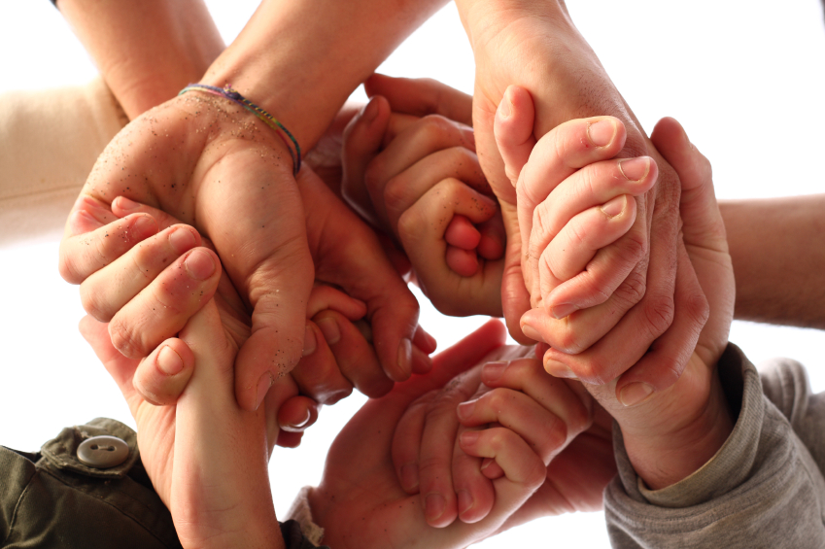
National Workshop
Neuroscience Communication in emerging economies: the challenge of change
Date: 27th Oct. 2012, 12 noon
Venue: Guru Nanak Bhawan Auditorium
Guru Nanak Dev University, Amritsar

Slide 2
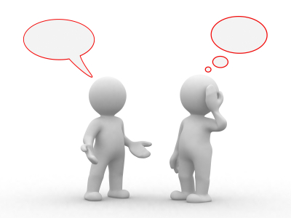
Agenda
S.No | 27th Oct,2012 |  | Time
1 | Welcome address | Overview of Workshop | 12.00-12.05 pm
2 | MC Arunan Sophia College for Women, Mumbai | Learning Sciences | 12.05-12.20 pm
4 | Geetika Sareen Medknow Publications and Media Pvt. Ltd. Wolters Kluwer Health Medical Research | How to get published in scientific journals | 12.20-12.35pm
6 | Akshay Anand Deptt of Neurology, PGIMER Chandigarh | Improving Neuroscience Communication | 12.35-12.50pm
8 | Sangram Patnaik Supreme Court New Delhi | Copyright and Plagiarism: Indian Scenario | 12.50-1.05pm
9 | Prashant Mishra Country Manager India, BMJ Group | BMJ Group: helping you with your education and research | 01.05-01.20 pm
10 | Panel Discussion |  | 01.20-01.40 pm
11 | Proposing a vote of thanks |  | 01.40-01.45 pm

Slide 3
Dear Colleague
“Society exists through a process of transmission quite as much as biological life. This transmission occurs by means of communication of habits of doing, thinking and feeling from the older to the younger” remarked John Dewy a philosopher, psychologist and educational reformer
Communication in today’s fast changing world holds its own importance. Many developments are taking shape in the fields as diverse as Engineering, Filmmaking, Business or Science. An artist showcases his thoughts in his paintings, a filmmaker presents his ideas on screen. Similarly, a scientist showcases his research work in a Journal. The spark to explore keeps the fire of learning and sharing always alive finding representation in one or other medium of expression. This symposium on Neuroscience Communication is being organized to bridge the gap between students, basic scientists and the physicians on one side and the editors and publishers on the other side. In order to advance our knowledge of this vital interaction as well as the advancements in the field of neuroscience communication and education invited talks will be delivered by prominent individuals in the field. This will be followed by discussions. The workshop will discuss the current challenges in the field, attending limitations and tasks ahead. As explained by John locke, one of the Philosophers of 16th century, “No man's knowledge here can go beyond his experience.” Each person whether from medicine or scientific background own their set of experiences which cannot be explored further if not questioned, if not brought to light though an expression medium. Communication plays a vital role in building experiences into shared knowledge strengthened by author’s copyrights and other mechanisms of information sharing by various indexing agencies.
Stem Cells applications are replete with controversies and benefits which need further studies. Challenges in communicating the applications of neural stem cells to public, patients and media will be discussed by experts.
We invite trainees, faculty, publishers and editors to share their experiences on this unique platform

